Slide 1
New Ideas and Prototypes

Slide 2
My In-Person Interview with Lloyd,
MS Forms is difficult
During the interview, Lloyd informed me that the Microsoft Forms idea would be difficult to implement because the TEFAP form changes frequently, and it would have to be manually converted by hand into a digital form every time.
I have two ideas on how to create a digital form system that can adapt to different PDFs.

Slide 3
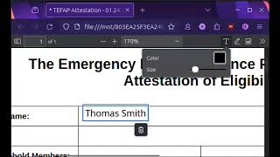
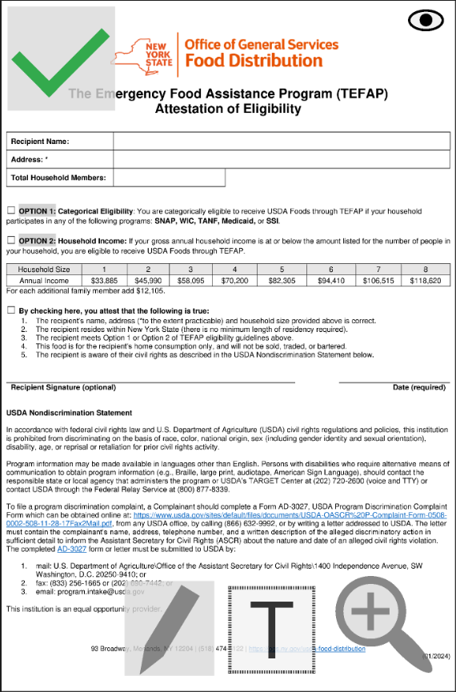
Idea 1: PDF Editor
The Firefox browser has an excellent PDF editor built-in. Because this PDF editor is open source, it could be modified to make it easier to use on mobile devices and reduce the number of buttons to just what is needed to fill out the form.

Slide 4
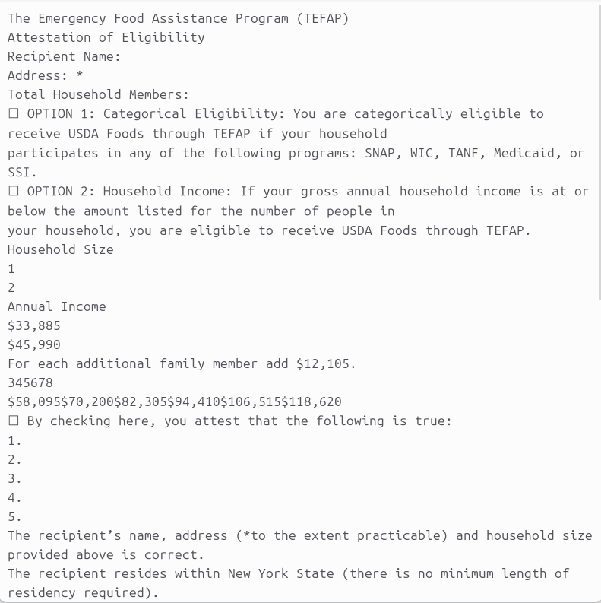
Idea 2: Scanning PDF for Inputs
The TEFAP forms contain text that a computer can read. Because of this, it might be possible to create a tablet app that reads the text in the PDF and automatically finds inputs. This would use the open-source “Poppler” library to read text. All lines that are followed by a colon will be considered inputs. The signature and date inputs don’t contain any colons, so these would be detected using the words “Signature” and “Date” (the code would also need to include “Signature” and “Date” in other languages).

Slide 5
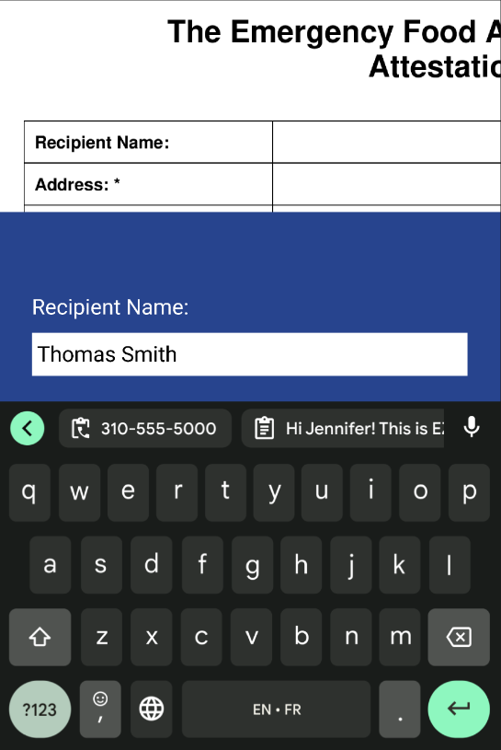
Scanning PDF for Inputs Prototype
Here is a prototype made in Figma that shows what the interface for this program might look like. For each input that the program finds, it will zoom in on that part of the PDF, then have a text box below for input. The user would be able to drag their finger along the pdf part of the screen to pan it and read text that might be cut off.

Slide 6
Thank you!

